Slide 1
Agile Developer Practices

Slide 2
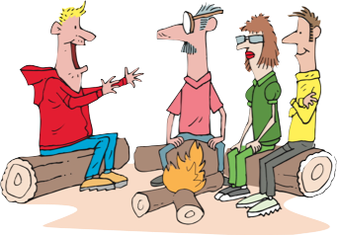
Story 1
Role: As a marketing executive
Goal: I want to have different pricing for newly released movies
Value: So that I can increase my profit

Slide 3
Story Details
Pricing Model for newly released movies:
Up to 2 days $3 and after that everyday $2
e.g.
1 day rental - $3
2 day rental - $3
3 day rental - $5 ( $3 + $2)
4 day rental - $7 ($3 + (2*$2))

Slide 4
Story 2
Role: As a marketing executive
Goal: I want to have different pricing for classic movies
Value: So that customer can enjoy classic movies for long duration with low rentals

Slide 5
Story Details
Pricing Model for classic movies:
Everyday $0.5, for a week $3 and after than everyday $0.5
e.g.
1 day rental - $0.5
2 day rental - $1
7 day rental - $3
8 day rental - $3.5 ($3 + $0.5)
Note: enhance application to allow upto 10 days of rental

Slide 6
Mocking exercise
Login and Logout controller unit tests

Slide 7
Story 3
Role: As a marketing executive
Goal: I want to have frequent renter points program
Value: So that so that customer can win free movies and we get recurring customers

Slide 8
Frequent Renter Points
Newly Released Movies
2 points per day
All others
1 point per $ spent

Slide 9
Story 4
Role: As a customer
Goal: I want to view my accumulated frequent renter points
Value: So that so that I know when I get the free movie

Slide 10
Story 5
Role: As a customer
Goal: I want to view all my previous receipts as history
Value: So that so that I know my history of transactions

Slide 11
Story 6
Role: As a customer
Goal: I want to return my video (single video return using current rentals screen)
Value: So that I complete my transaction

Slide 12
Story 7
Role: As a store manager
Goal: I want to manage video inventory per movie basis
Value: So that I know when run out of stock

Slide 13

Thank You
Copyright 2009 ThoughtWorks, Inc.
www.thoughtworks.com
Notes:
Thank you for joining us for The Origins of Agile Software Development, a module in Agile Fundamentals. The next module in the series is The Agile Core, in which we’ll explore some of the practices and methodologies that make Agile what it is.
Until the next time, we wish you well.

